Slide 1
Autonomous Localization of BWI Bots
Nevyn Duarte, Shreyas Konana, Joseph Moyalan, Ishan Phadke

Slide 2
Introduction
The problem we want to solve is making the robot fully autonomous immediately upon startup
Robot currently uses a 2D pose estimate and navigation goal to localize
Both require human input
Manually estimating robot’s location on a map can lead to significant errors

Slide 3
Introduction
Our goal: solve this issue by using an implementation of frontier exploration to explore surroundings and look for strategically placed alvar markers
Markers tied to positional data
Markers would eventually be replaced by actual objects located in GDC
Ultimately, automatically localizing a bot is key in the effort to make it truly autonomous

Slide 4
Background
Robot localization: process of determining location of bot with respect to its environment
Current method used: Monte Carlo Localization algorithm
Localizes using a particle filter that represents a distribution of likely states
Estimates position as the bot moves around, given a map of surroundings
Generates random guesses of where the bot is going to be next
Inconsistent guesses are thrown out; more guesses are made that appear consistent with the environment
Towards the end, most particles should converge to actual location of robot

Slide 5
Background
Probability density function is used to estimate robot’s current state
A state space that contains several particles indicate a higher likelihood the robot is at a particular position
Probability of current state relies exclusively on the previous state
Robot has no information on current pose immediately upon startup
The problem: A poor 2D pose estimate will lead to each subsequent state being inconsistent

Slide 6
Original Approach
Stage 1: Intelligent Frontier Exploration Using AR Tags
Modify frontier exploration package to make educated guesses on the position of an alvar marker
Alvar markers represent where real world objects are most likely to be located
We want to explore areas with larger openings over smaller openings
Larger openings = larger space = more likely to find alvar marker
Explore areas along walls more thoroughly
Objects are not as likely to be in the middle of a hallway

Slide 7
Original Approach
Stage 2: Object Recognition
Involves building a database of permanent objects around the GDC tied to positional information
Use YOLO to distinguish between these objects, and train it to identify them from several different angles
The challenge of this is effectively using YOLO in concordance with our algorithm
Would eliminate the need to have alvar markers

Slide 8
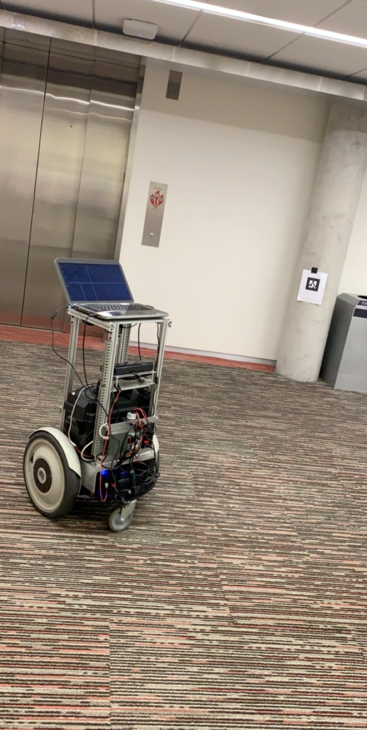
Experimental Setup / Evaluation
Using frontier exploration on the BWI bots proved to be more difficult than we thought
Major differences in formatting between the BWI and frontier exploration’s launch files

Slide 9
Experimental Setup / Evaluation
We decided to make our own makeshift implementation of frontier exploration
Creates random navigation goals in a circle surrounding the robot
Relies on robot’s sensors to ensure it doesn’t run into walls/objects
As soon as an alvar marker is found, the robot reads in the marker’s ID and gets positional data from a text file
Now, the robot knows exactly where it is with respect to third floor GDC elevators

Slide 10
Results
We successfully implemented a program to get the robot to move around randomly and search for an alvar marker
We populated an AR marker and stored the positional data of it (in relation to the elevators) in a file with the key as the header of the AR tag

Slide 11
Results
We had lots of difficulty recognizing the AR marker during the robots random movement.
Very Inconsistent
Only recognized AR markers randomly
Goes into recovery mode often
Due to time constraints, we could not successfully get the robot to always recognize the markers.
We were still able to reverse the transformation from the marker to the robot
When recognized would give us the robot’s location

Slide 12
Discussion
Current implementation is only about 50 percent effective
Closer to true autonomy
Accuracy, precision, timing as compared to 2D pose estimate

Slide 13
Conclusion
Ultimately, we were trying to solve the problem of autonomously localizing a robot
Our approach was to implement a makeshift version of frontier exploration
We created an algorithm to randomly explore the bot’s surroundings and look for alvar markers
Alvar markers were populated with positional data and stored in a file
When these alvar markers were recognized, the transformation would give us the robot’s location

